Slide 1
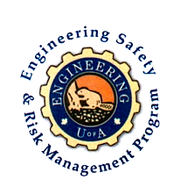

Fundamentals of RM
RM System and Process
Leadership in RM
Incident Investigation
RM Tools & Challenges
RM in Industry
People & Org.
Application and Perspectives
On Becoming a Leader In Risk Management
ENGG404 - Lecture
Case 1: Sunrise Propane Explosion
1
Notes:
ESRM-LRM Lecture 00 - Day 1
2012 Fall
1
1

Slide 2
Learning Outcomes:
Recall and explain the basic information of this loss incident. It is used to illustrate several concepts throughout the course.
Explain why engineering safety and risk management systems and processes are critical to the success of industrial and institutional operations.
Interpret the given information along with the expertise of the student's work group, and infer or surmise additional and relevant information.
Case 1: Sunrise Propane Explosion
2
Notes:
2

Slide 3
The Sunrise Propane Explosion Incident
Key model case study that illustrates:
Hazard identification and risk analysis;
Triggering event and incident escalation;
Impact on PEAP;
Incident investigation and analysis;
Immediate causes, basic causes, and latent (root) causes;
Leadership in an industrial operation (or lack thereof).
Case 1: Sunrise Propane Explosion
3
Notes:
ENGG406 Lecture 00 - Day 1
2012 Fall
3
3

Slide 4
Summary of Event and Losses:
What Happened:
Illegal truck-to-truck transfer of liquefied propane gas.
The transfer hose failed.
Propane vaporized, gas cloud formed, and exploded.
Large fire.
Losses:
Two workers killed.
Homes and offices damaged.
Evacuation within 1.6 km radius.
Class-action suit and litigation.
Case 1: Sunrise Propane Explosion
4
Notes:
ENGG406 Lecture 00 - Day 1
2012 Fall
4
4

Slide 5
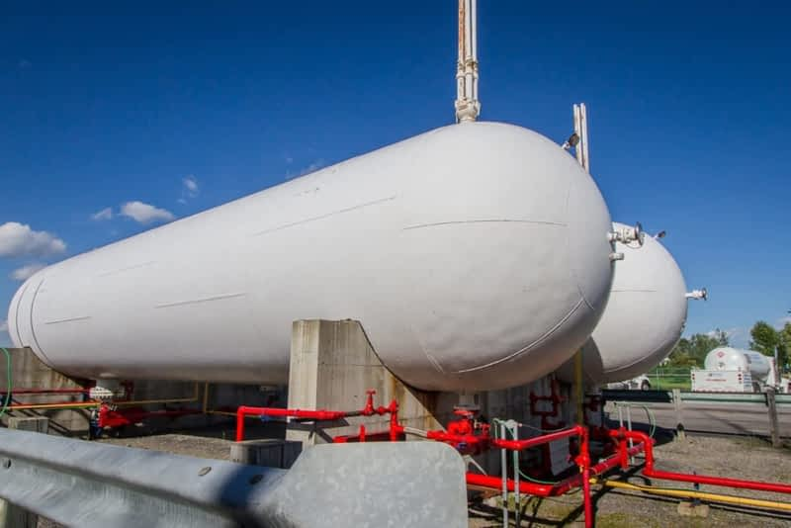
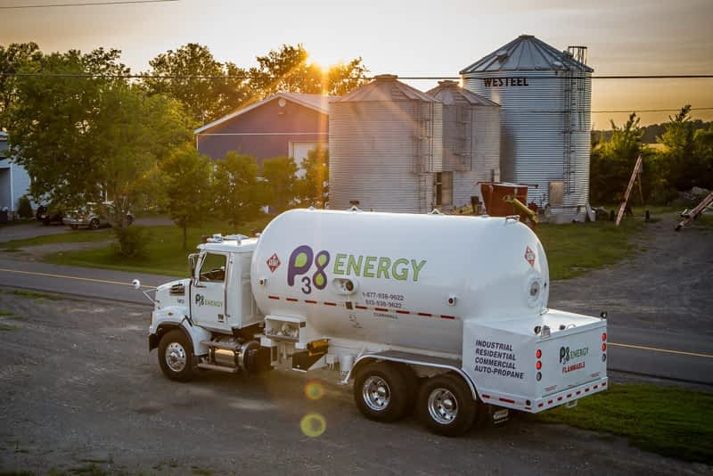
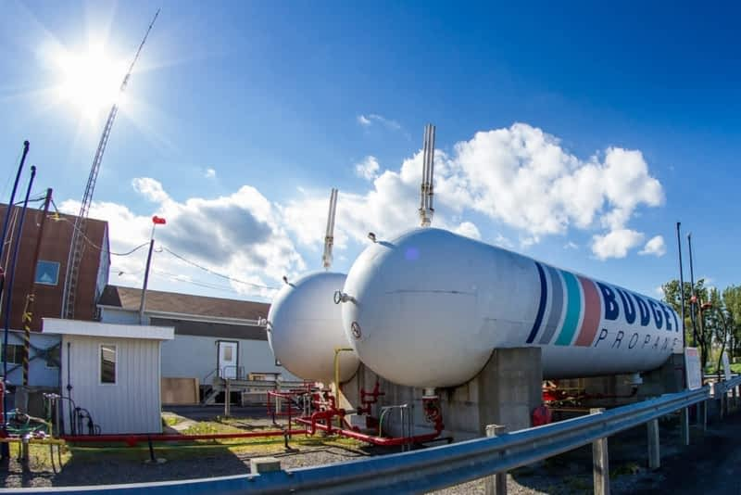
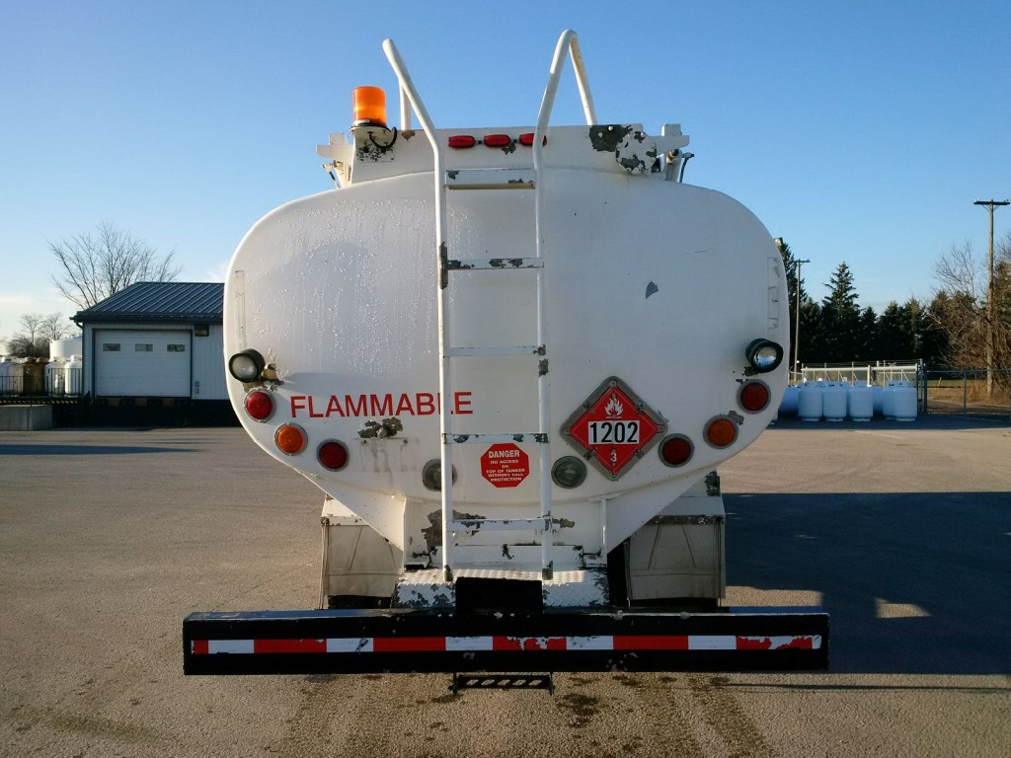
What is a T2T transfer? Why would they do it?
Case 1: Sunrise Propane Explosion
5
Notes:
5

Slide 6
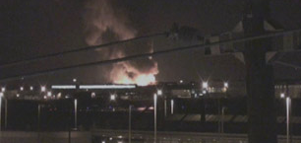
Summary of Event & Video on e-Class:
A media report ...
“At approximately 03:50 ET on the morning of August 10, 2008, a large explosion occurred at Sunrise Propane Industrial Gases. This was followed by a series of explosions which sent large fireballs and clouds of smoke billowing into the sky. Two workers were killed. Large pieces of metal from the exploding propane tanks were ejected onto nearby streets and properties. Many homes and offices were damaged, windows were shattered, and doors were ripped from their hinges. About 200 firefighters battled the five-alarm fire that resulted from the explosions. The threat of further blasts and concerns about the air quality forced the police to conduct a voluntary evacuation of a large area in the surrounding community. Residents living within a 1.6 kilometres (1 mile) radius were told to leave their homes in the early hours of the morning.
August 10, 2008, ~3:50AM, Sunrise Propane Industrial Gases
Case 1: Sunrise Propane Explosion
6
Notes:
6

Slide 7
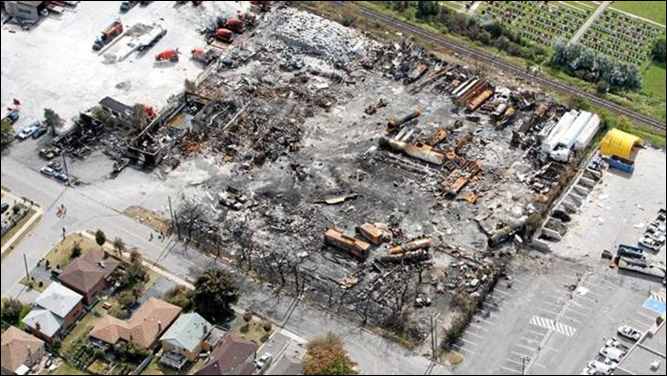
This Course is About Leadership in Risk Management:
This and other events (our case study inventory), Tianjin Industrial Area (129 killed, >60 missing, >700 injured), Lac Megantic (49 killed), Mount Polley Tailings Pond, etc. are tragic … and all are preventable.
This course is about managing our businesses to prevent such events.
Case 1: Sunrise Propane Explosion
7
Notes:
7

Slide 8
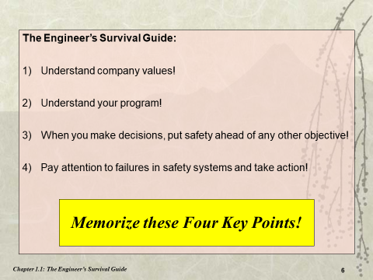
Which one(s) apply and why? Let’s have a discussion…
In fact, a case can be made for all of these.
Case 1: Sunrise Propane Explosion
8
Notes:
8

